Slide 1
ResearchSpace as an Example of VRE based on CIDOC CRM
Vladimir Alexiev, PhD, PMP Data and Ontology Group, Ontotext
COST Action IS1005, Medioevo Europeo VCMS Meeting, Bucharest, Romania, 26-Apr-13

Slide 2
Presentation Outline
About Ontotext
European projects
Clients
Commercial projects (especially in Cultural Heritage)
The ResearchSpace project
Video by Dominic Oldman
Inference and Search with CIDOC CRM

Slide 3
About Ontotext
Innovative BG company, global leader in Semantic Technology software
Semantic database (repository): OWLIM
Text analytics, semantic annotation and search: KIM
Web mining: job offers, cars, recipes, etc.
Life Sciences and pharmaceuticals
Data integration, transformation, metadata and ontology management, Linked Data
Cultural Heritage (CH)
Established in 2000 as a laboratory within Sirma Group (largest private Bulgarian software holding)
Received venture funding and spun off as separate company in 2008
65 employees and contractors, offices in Bulgaria (Sofia, Varna), UK (London), USA

Slide 4
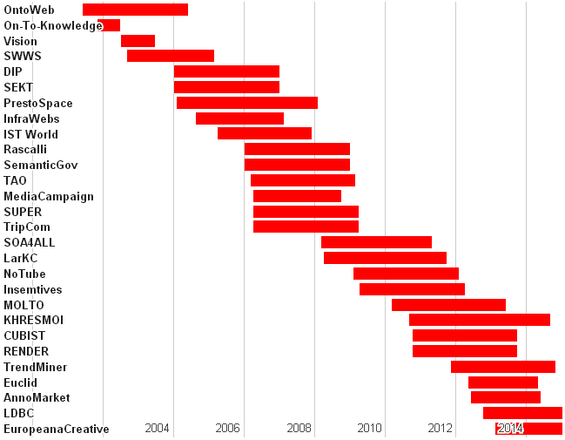
European Research Projects
http://www.ontotext.com/research

Slide 5
Current European Projects
Current research projects relevant to Cultural Heritage include:
MOLTO - Multilingual Online Translation - developing tools for translating texts between multiple languages in real time with high quality. Ontotext leads a Museum use case for the Gothenburg City Museum
RENDER - Reflecting Knowledge Diversity - developing methods, techniques, software and data sets that will leverage diversity as a crucial source of innovation and creativity. Techniques developed together with Google for relating news articles to Linked Open Data, and for clustering entities, can be used profitably on CH data.
EUCLID - Educational Curriculum for the usage of Linked Data - professional training curriculum for data practitioners aiming to use Linked Data in their daily work. Strongly relevant to cultural heritage metadata specialists and other experts focusing on Linked Open Data

Slide 6
Current European Projects
AnnoMarket - Cloud-Based Text Annotation Marketplace - aims to revolutionize the text annotation market, by delivering an affordable, open marketplace for pay-as-you-go, cloud-based extraction resources and services, in multiple languages. Multilingual semantic entity extraction from cultural heritage text (e.g. museum object descriptions) is an important and largely unsolved problem. Ontotext's strong experience in this domain, as well as this particular project, provide important avenues for addressing the problem.
LDBC - Linked Data Benchmark Council - aims to establish a global, vendor-neutral, non-profit organization for publishing and auditing benchmark results for graph and RDF databases. Cultural heritage institutions that decide to use semantic repositories require such information, and at the same time can provide important feedback for
Europeana Creative - re-use of cultural heritage metadata and content by the creative industries. Improve the usefulness and kick-starting the professional use of Europeana data. Ontotext plays a core role in the heart of the developed system, namely the Content Re-use Framework. Europeana EDM semantic data SPARQL endpoint (1B triples)

Slide 7



















Some Ontotext Clients
http://www.ontotext.com/clients

Slide 8
Projects in Cultural Heritage
The National Archives (UK ): Semantic Knowledge Base
The British Museum (UK): ResearchSpace project funding from Andrew Mellon Foundation
Yale Center for British Art (USA): Linked Open Data publishing of museum collection
National Gallery of Art (US): ConservationSpace project funding from Andrew Mellon Foundation
Bulgaria-Korea IT Cooperation Center: semantic publishing of key cultural heritage collections
Bulgariana: aggregator to contribute Bulgarian content to Europeana
Dutch Public Library (Netherlands): cultural heritage aggregation
Projects using Ontotext technology: 3D COFORM, V-MUST, IdeaGarden, CHARISMA, LODAC. Polish Digital National Museum…

Slide 9
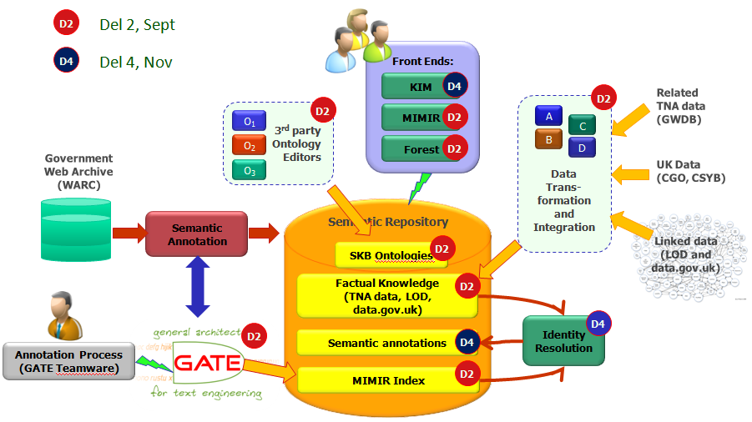
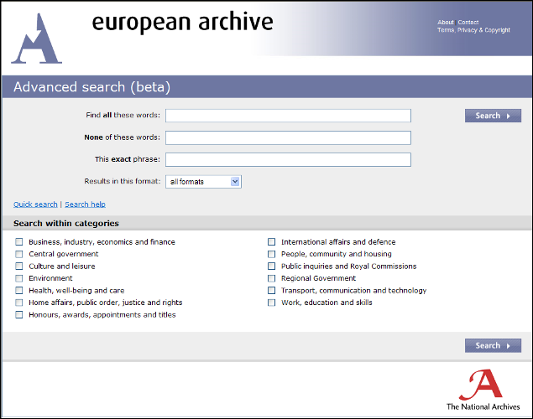
UK National Archives: Semantic KB
Semantic index for the entire UK Government Web Archive
700M documents: 42TB, 1.3B files
160M unique documents after de-duplication
Background knowledge (UK Government Ontology): 5B facts
Automatic text analysis: extracted 3B facts of metadata
Faceted semantic search in KIM
33K hours of cloud processing; up to 500 servers
www.ontotext.com/case/nationalArchives-skb

Slide 10
ResearchSpace
Support collaborative research projects for CH scholars
Open source framework and hosted environment for web-based research, knowledge sharing and web publishing
Intends to provide:
Data conversion and aggregation
Semantic RDF data sources, based on the CIDOC CRM ontology
Semantic search based on Fundamental Relations
Data analysis and management tools
Collaboration tools, such as forums, tags, data baskets, sharing, dashboards
A range of research tools to support various workflows, e.g. Image Annotation, Image Compare, Timeline and Geographical Mapping...
Web Publication
Semantic technology is at the core of RS because it provides effective data integration across different organizations and projects.
Uses Ontotext's OWLIM semantic repository featuring powerful reasoning (equivalent to OWL2 RL), fast performance, efficient multi-user access, full SPARQL 1.1 support, and incremental assert and retract.
Stages
Stage 3 (Working Prototype) developed between Nov 2011 and Apr 2013.
Stage 4: expected to start in 2013, with more development and more museums and galleries coming on board

Slide 11

RS Video by Dominic Oldman
http://www.youtube.com/watch?v=HCnwgq6ebAs
QR code:

Slide 12
RS Semantic Search
Allows a user that is not familiar with CRM or the BM data to perform simple and intuitive searches.
Features:
Uses CRM Fundamental Relations (FR) that aggregate a large number of paths through CRM data into a smaller number of searchable relations (described below)
Has an intuitive "sentence-based" UI
Searches can be saved, bookmarked (put in a "data basket"), edited, shared between users
Auto-completion across all searchable thesauri. The available FR and appropriate Thesauri are coordinated, eg once the user selects FR "Thing created by Actor", the auto-completion is restricted to the thesauri BM People/Institutions, BM Nationalities, RKD Artists
Search across datasets. E.g. once the entity "Rembrandt" is co-referenced between the BM People and RKD Artists thesauri, paintings by Rembrandt can be found across the BM and RKD datasets
Details, thumbnails (lightbox) and list view
Faceting of search results, timeline mapping

Slide 13
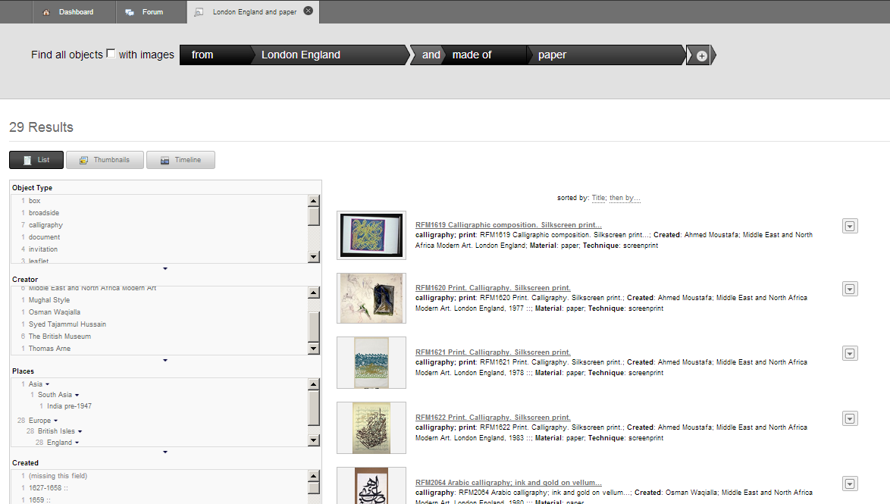
RS Semantic Search

Slide 14
RS Image Annotation
Core functionality for collaborative research on paintings and high-resolution photos. Features:
Draw arbitrary shapes over an image (most open-source annotation tools allow only rectangular shapes). We use the open-source library SVG-Edit. Scalable Vector Graphics (SVG) supports shapes, colors, different line styles, markers and more.
Deep Zoom support for high-resolution (multi-gigapixel) images. We use the open-source IIP Image Server. Annotations can be created at any zoom level, and are scaled accordingly at different levels
Attach any semantic object, comment, replies and threaded discussions to shapes
Image overlay and blending (limited version, to be extended)
Annotations are saved using the OpenAnnotation ontology (Mellon funded)

Slide 15
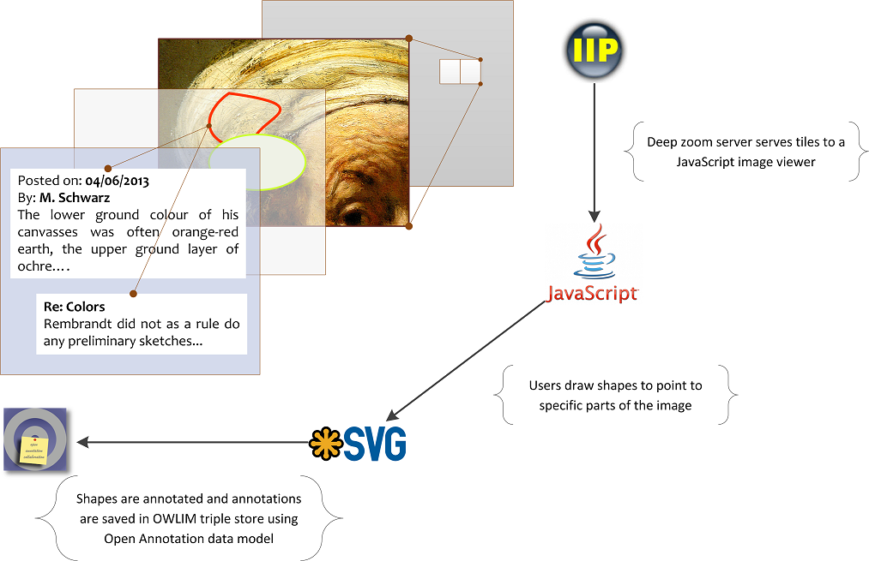
RS Image Annotation Architecture

Slide 16
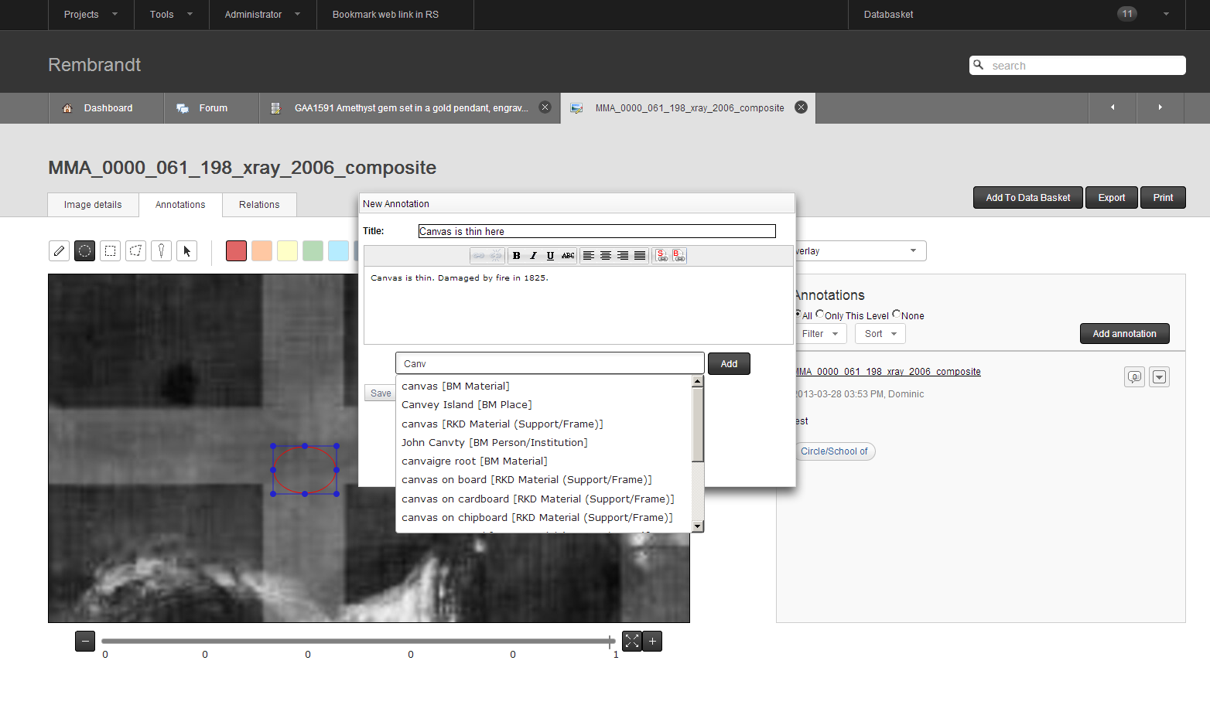
RS Image Annotation

Slide 17
RS and CIDOC CRM
CIDOC CRM: appropriate for cultural heritage, historic discourse, archaeology
Supports generic description of cultural artifacts, people, places, sites, related events (e.g. creation, acquisition, finding, curation, conservation), cultural periods.
Standardized as ISO 21127:2006, but undergoes continuing development.
CRM is at the heart of ResearchSpace
Ontotext helped the British Museum to develop its mapping to CIDOC CRM, and Best Practice guidelines that other museums can use.
Ontotext gained strong experience with CRM and is very active on the CRM Special Interest Group (CRM SIG).
We promote CRM extensions and corrections that facilitate real interoperability and federation between collections of different institutions
Vladimir Alexiev. Types and annotations for CIDOC CRM properties. In Digital Presentation and Preservation of Cultural and Scientific Heritage (DiPP2012) conference (Invited report), Veliko Tarnovo, Bulgaria, September 2012.
Ontotext is organizing workshop Practical Experiences with CIDOC CRM and its Extensions (CRMEX 2013)
Accepted for Theory and Practice of Digital Libraries (TPDL 2013), 26 Sep 2013, Malta.
Generated a lot of interest in the CRM community

Slide 18
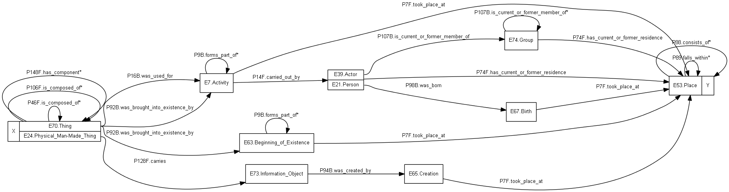
RS Search Implementation
RS search is implemented using the idea of CRM Fundamental Relations (FRs).
FRs aggregate a large number of paths through CRM data into a smaller number of searchable relations, allowing a more intuitive search.
For example, the FR "Thing from Place" can be defined as this CRM network:
First working implementation of FR search over large data.
Use OWLIM Rules: reasoning power equivalent to OWL2 RL, efficient incremental updates
We implemented 20 FRs using 104 rules and about 40 sub-FRs.
Vladimir Alexiev. Implementing CIDOC CRM search based on fundamental relations and OWLIM rules. In Workshop on Semantic Digital Archives (SDA 2012), Theory and Practice of Digital Libraries (TPDL 2012), Paphos, Cyprus, September 2012. CEUR WS Vol.912

Slide 19
CRM Reasoning, Performance
One of the first datasets to be made available in RS for search, annotation and other research is the complete British Museum (BM) collection
2M museum objects, 53M RDF nodes, 194M explicit statements, 1.5B total statements.
Inference
Each explicit statement generates 7 statements, inferred through forward chaining and stored using materialization
This high ratio of inferred statements is due to the deep class hierarchy of CRM (about half of all statements are rdf:type), transitively closed and inverse properties
The search FRs generate about 6% of all statements.
Despite this large amount of data, OWLIM provides good search response times.
Exciting demonstration of large-scale reasoning with real-world data: no other repository has demonstrated such expressive reasoning with more than 5-10M synthetic statements

Slide 20
RS Impact, Quotes
I have started showing people the tools in ResearchSpace. Our keeper of Africa, Oceania and the Americas department was very impressed and complimentary and was able to see how it would benefit her and particularly her department's ethnographic pictorial archives. The search system works very well with historical photographs! I am sure that many others will appreciate your work as well as I show them.
Dominic Oldman, IS Development Manager, the British Museum, and ResearchSpace Principal Investigator
The Collections Trust will be working with the British Museum to explore the implications of this new Create Once, Publish Everywhere (COPE) approach, and to share it as widely as possible with the museum, gallery and built heritage communities. Building on the existing work of our SPECTRUM Partners, we hope to connect leading software providers with this initiative to ensure that the current and future generations of software tools for heritage management support the COPE approach.
Nick Poole, CEO, Collections Trust
ResearchSpace is an interesting case in point - it is, at heart, a linked open data documentation system on steroids. But its look and feel wouldn't be out of place in a high-end enterprise application... An environment which is neither front-of-house, nor back-office, but both at the same time. It does a hardcore, complex museum job, but it does it in an environment which would (I think) feel as comfortable for a casual user as it would for an academic researcher or expert curator.
Nick Poole, CEO, Collections Trust

Slide 21


VCMS Remarks
VCMS Concept from four points of view
Top-down: researcher goals, scenarios, primitives
Bottom-up: semantic catalog of data sources and their structure
PM: program/project structuring, plan proposal, split writing work
Lateral: semtech and text analysis innovations and opportunities
Thoughts on the VCMS process
Think about bridge funding so you can engage companies
Be more daring: Ask and ye shall receive
Data sources network (avalanche) effect
More interaction between Digital Humanities community and IS
We need this and not that

Slide 22

Thanks for listening!
Questions? vladimir.alexiev@ontotext.com

